Slide 1
Cloud-based News ChatBot
Krishna Taduri
Peeyush Dyavarashetty
Rahul Velaga
Subha Venkat Milind Manda
Srijinesh Alanka

Slide 2

Problem Statement
Overwhelming amount of information of news online.
Manually searching for the articles is very time consuming.

Slide 3
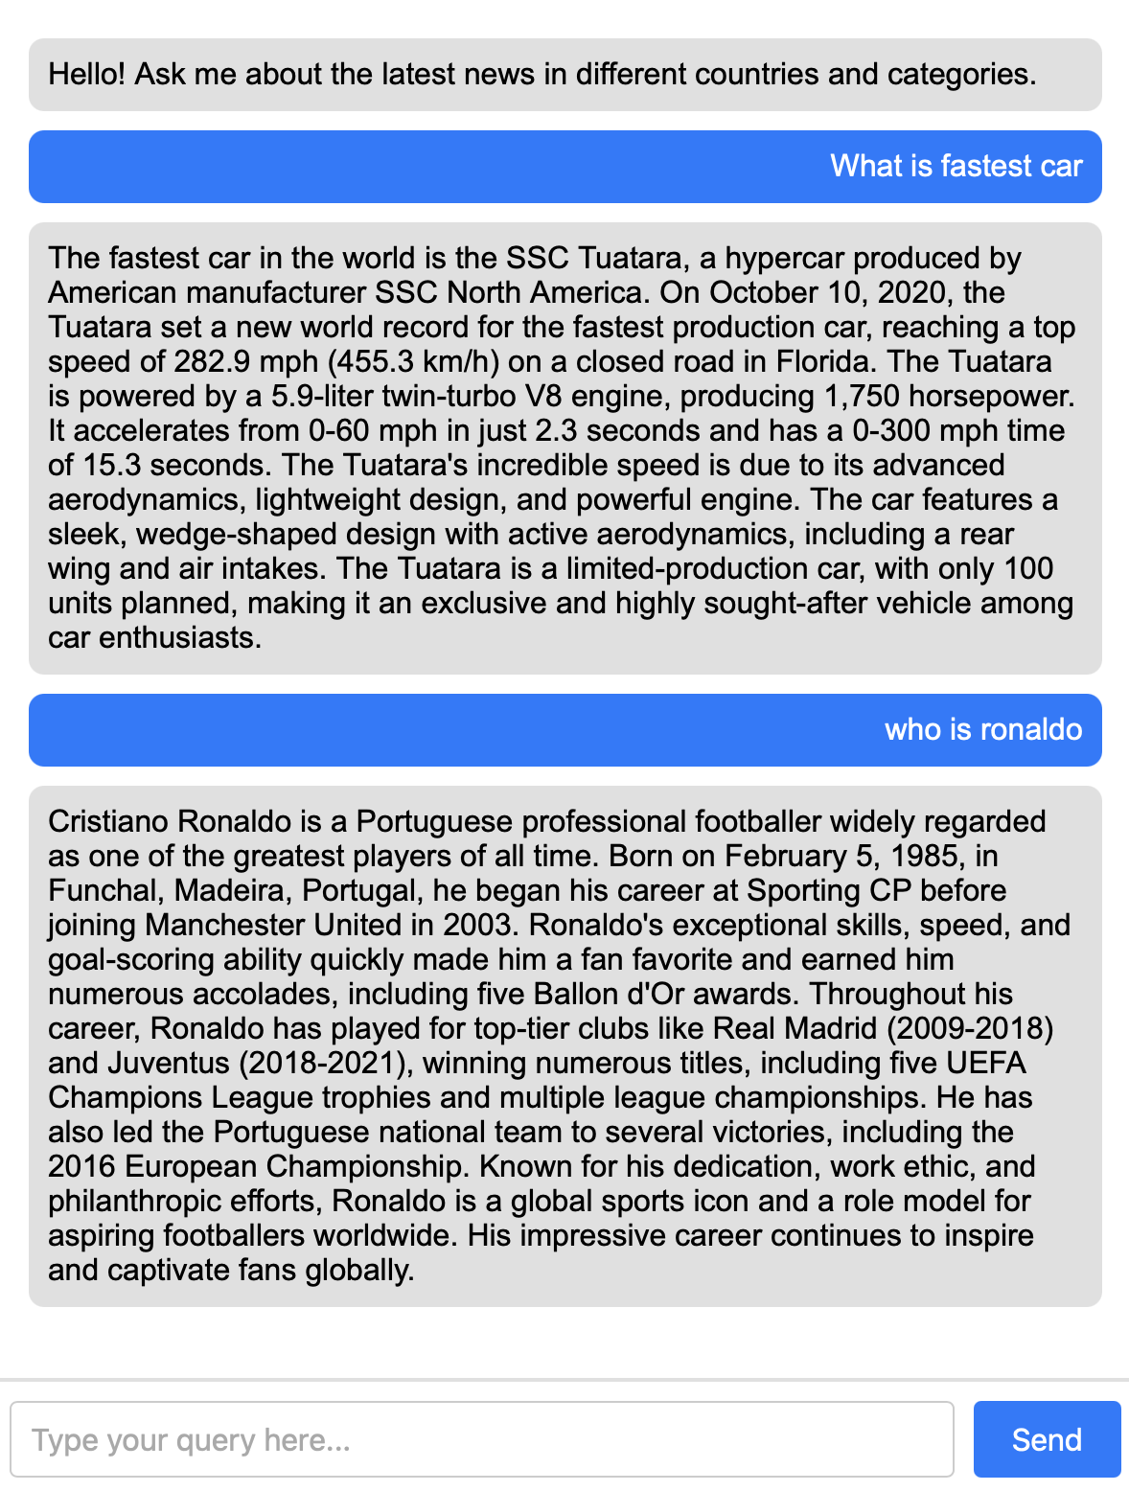
Proposed Solution
AI-powered chatbot using advanced cloud technologies.
Simple and quick for everyday use.
Accessible via any modern web browser.
Custom-tailored responses based on user queries.
Focused on providing concise news summaries.

Slide 4
Key features
Real-time news fetched using News API.
Machine learning generates concise article summaries.
Fully serverless architecture ensures scalability.
Deployed on AWS for high availability.
Supports multiple countries and news categories.
User-friendly interface for seamless interaction.

Slide 5
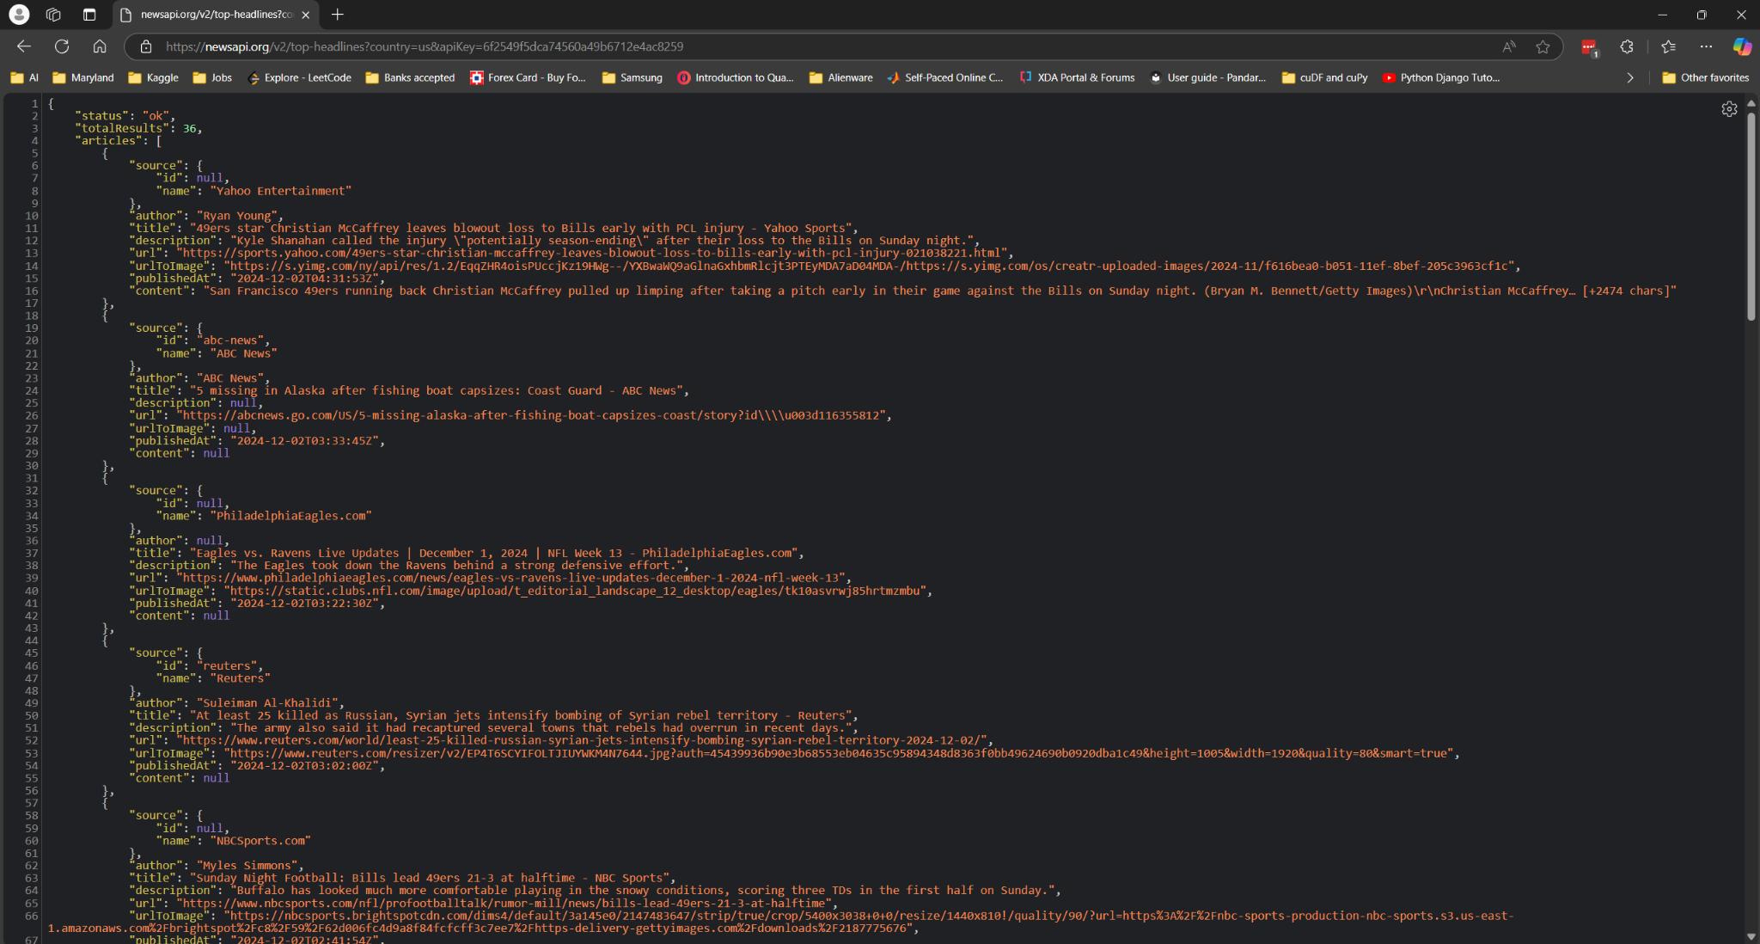
NewsAPI data format

Slide 6

Why AWS?
Serverless architecture.
Seamless Integration.
Supports powerful and efficient ML models.
Advanced encryption and IAM roles for security.
Modular Design.
Scalable and Cost Effective.

Slide 7

AWS Services used
Tech Stack
API Gateway: Sends messages between Lambda and localhost.
AWS Lambda: Triggers workflows, project backbone.
S3 Storage: Stores articles for further processing.
CloudWatch: Logs errors for debugging purposes.
AWS Bedrock: Runs large models for direct answers.
Honourable Mentions
SageMaker: Summarizes articles from NewsAPI.
ECR: Stores Docker images for SageMaker.

Slide 8

AWS S3
Secure, scalable, and cost-effective storage.
Integrates easily with API Gateway, Lambda and Bedrock.
Stores fetched articles efficiently in JSON.
Optimized for handling large-scale data.

Slide 9

AWS Lambda
Serverless compute for event-driven workflows.
Extracts country and category from query.
Fetches articles using NewsAPI.
Stores fetched articles in Amazon S3.
Triggers Bedrock to processes articles.
Cost-effective and highly scalable solution.

Slide 10

AWS Bedrock
Scales ML models via simple APIs.
Provides foundation models from top providers.
Cost-efficient with pay-as-you-go pricing.
Requires no advanced ML expertise.
Ensures user data security and privacy.

Slide 11

Project Flow
User Input: User types a specific query.
01
Keyword Extraction: Key terms (e.g., country) identified.
02
News API Call: Articles retrieved via AWS Lambda.
03
Query Answering: Articles are answered using AWS services.
04
Output: A single concise paragraph shown.
05

Slide 12
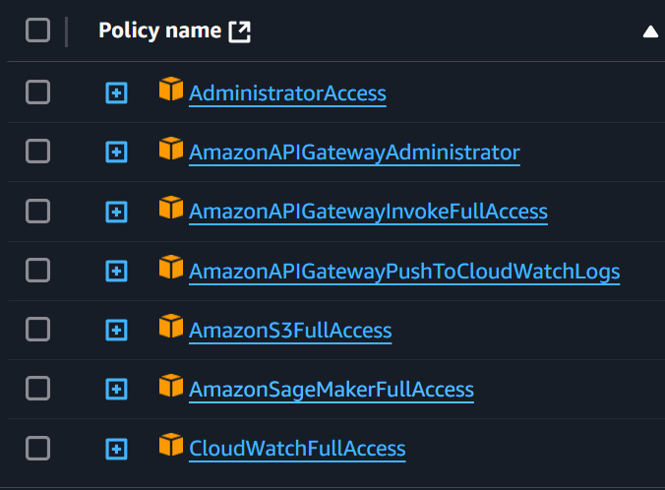
Roles: AWS Lambda
CloudWatchFullAccess: Logging lambda prints and errors in cloud
AmazonS3FullAccess: Store and Retrieve information from S3
AmazonSageMakerFullAccess: Full access to SageMaker models and algorithms

Slide 13
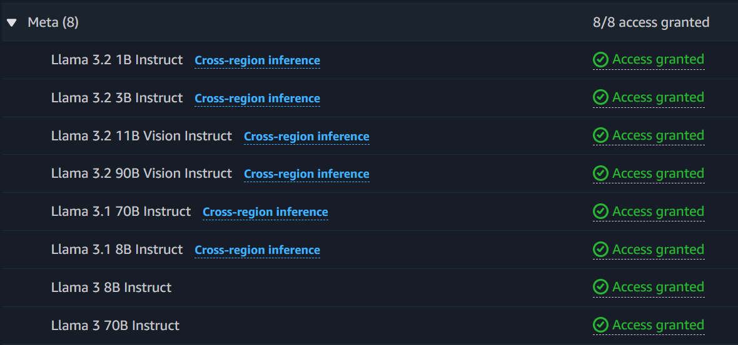
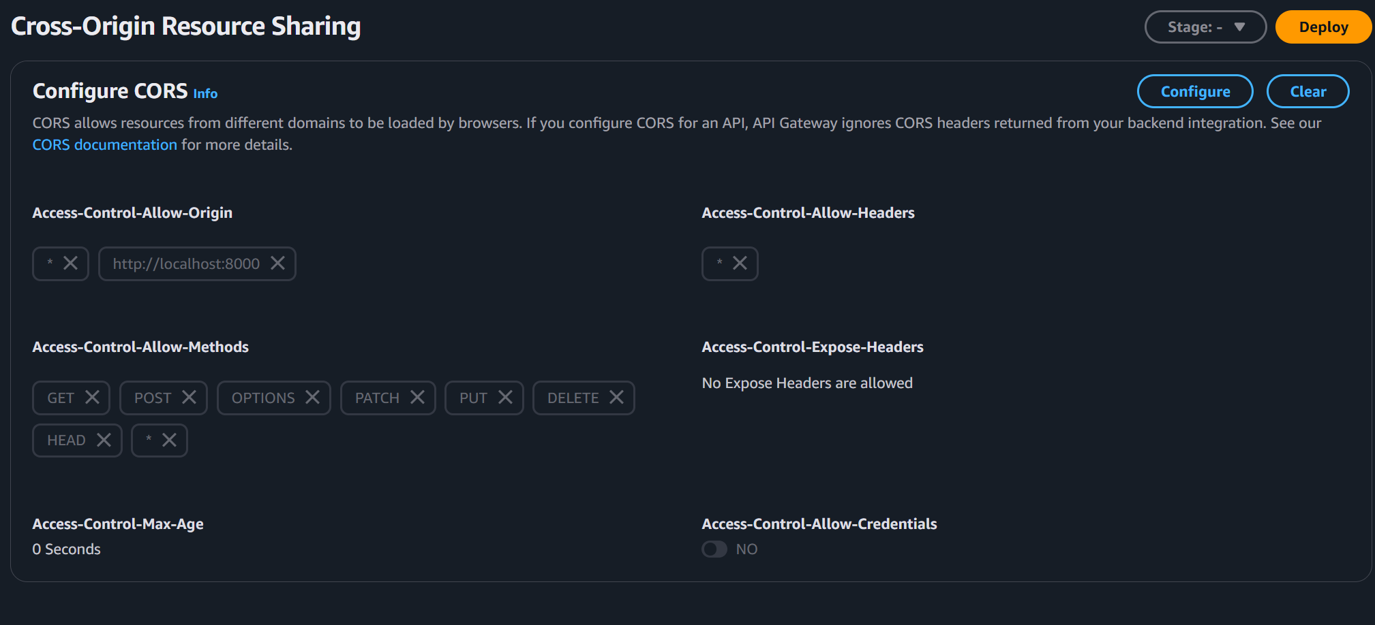
Permissions
AWS Bedrock
API Gateway

Slide 14
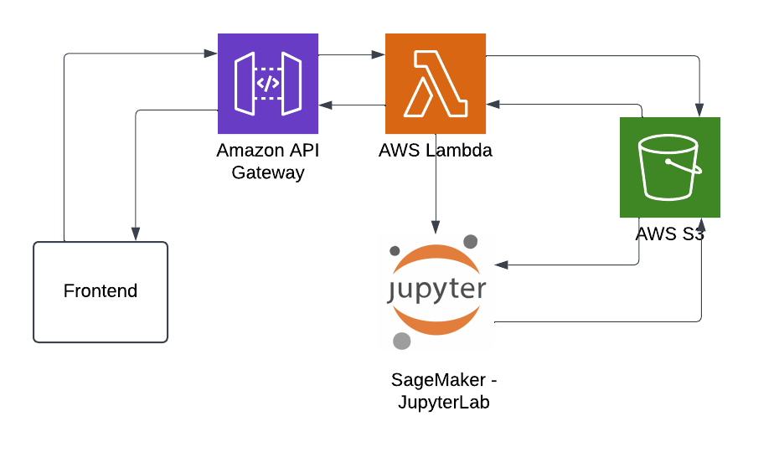
Attempt with JupyterLab
JupyterLab: Runs ML algorithm, stores results in S3.
Issues: JupyterLab required indefinite running, making it infeasible.

Slide 15
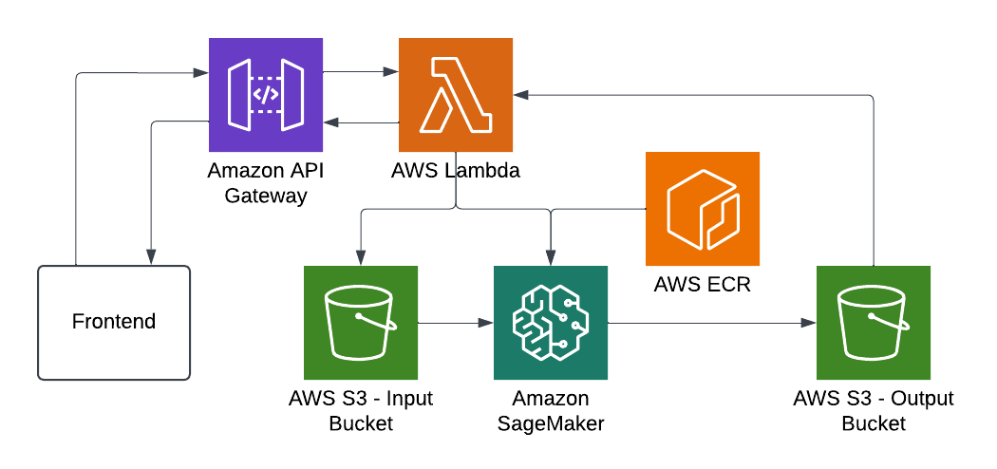
Attempt with SageMaker Endpoint
ECR Setup: Created custom Docker image for SageMaker.
Permissions: Granted full SageMaker access to roles.
Model: "distilbert-base-uncased-distilled-squad".
SageMaker: Used sagemaker.create_processing_job().

Slide 16
SageMaker endpoint: Problems faced
Model execution is very slow (~3 minutes).
Basic model yet requires significant runtime.
S3 to SageMaker parameter push is slow.
API Gateway limits requests to 30 seconds.
Need alternative to send results to frontend.

Slide 17
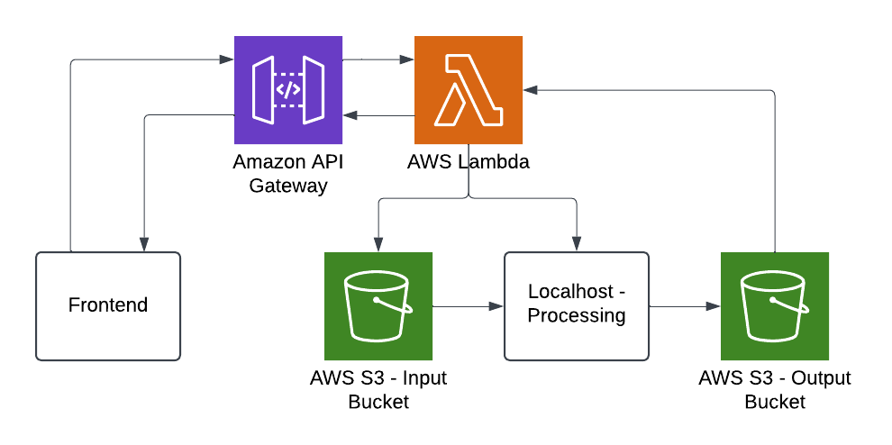
Attempt with Localhost computing
Localhost:
Fetches data via ngrok from S3.
Processes data and stores results in S3 OutputBucket.

Slide 18
Attempt with Localhost computing
Progress:
Tested multiple larger models for answers.
Built Docker images for these models.
Utilized ngrok for Lambda-localhost communication.
Challenges:
Larger models required excessive compute/storage.
Models failed to generate concise answers.
Further experimentation needed for model selection.
Issues connecting AWS Lambda to localhost effectively.

Slide 19
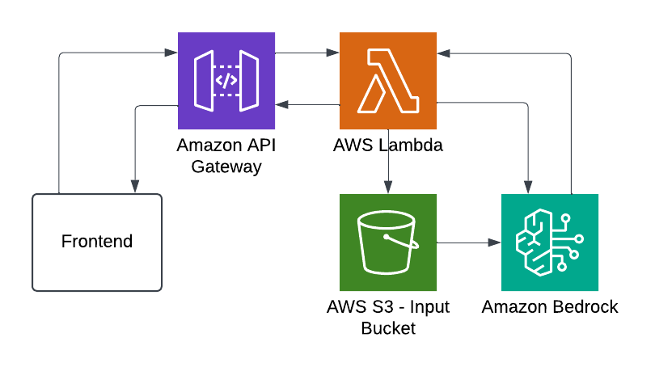
Working Model: Bedrock
AWS Bedrock: Fetches and processes data from S3.
Model Used: us.meta.llama3-2-90b-instruct-v1:0.
Query Format: "query: {Query} Answer in 150 words. context: {context}".
Notes:
23 s
Like api calling
Limited but powerful models

Slide 20

DEMO

Slide 21
Future Prospects
Enhanced Context: Include more sources beyond NewsAPI.
Pipeline Optimization: Remove unnecessary features for simplicity.
Chat History: Enable logging with DynamoDB integration.
Cost Reduction: Explore cost-efficient pipeline alternatives.
Frontend Improvement: Develop a cleaner and user-friendly interface.
Platform Integration: Deploy to WhatsApp or similar platforms.
Model Validation: Check and mitigate hallucination risks.

